Slide 1
Cloud Security
CyberCamp 2018
Ricky Payne CISSP, RHCE, RHCSA, Security+ , BS-IST, AS-CET

Slide 2

About Me
Over 12 years of progressive DevSecOps experience from Intern to CSO
Built “Gold Standard” federal security programs that produced 10+ federally certified systems.
Expert generalist: from pre-sales proposal work, policy and reference architecture development, requirements decomposition into agile sprints, proof of concepts, implementation, operations, and technical training to incident response.
Mentored/taught Windows and Linux security at CyberPatriot/CyberCamps since 2013. Accomplishments include 1st and 2nd in State and 1st in Regionals.
As a CSO for a federal SaaS, leads end-to-end Security, Privacy, and Operations for a FedRAMP Moderate (325 NIST 800-53r4 security controls) authorized SaaS hosted in AWS GovCloud.
Ricky Payne
CISSP, RHCE, RHCSA
Security+, BS-IST, AS-CET
grep.rickp@gmail.com
@RickPayne929

Slide 3
Agenda
What is the cloud?
Who uses it?
Who owns what? “Shared Responsibility Model”
Cloud Breach - Uber
Cloud Denial of Service (DoS) – AWS S3
Cloud Insider Threat
Cloud Security Framework parallels
Demo?

Slide 4
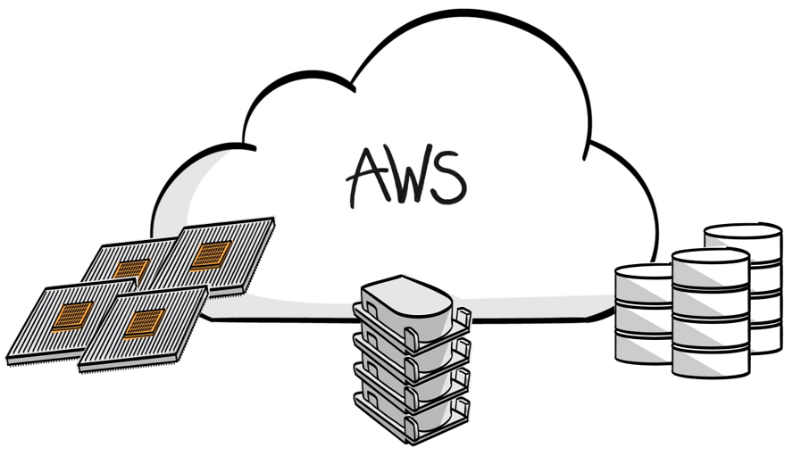
What is “the cloud”?
Notes:
Student Q&A to baseline understanding.
Relate via phones – iCloud, Samsung Cloud

Slide 5
What is “the cloud”?
Cloud computing is the on-demand delivery of compute power, database storage, applications, and other IT resources through a cloud services platform via the internet with pay-as-you-go pricing.¹
Cloud computing provides a simple way to access servers, storage, databases and a broad set of application services over the Internet.¹
Notes:
Renting computing resources.

Slide 6
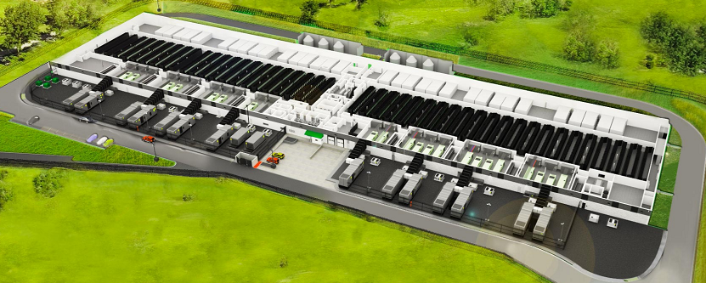
What is “the cloud”?
AWS Data Center²
Notes:
50-80k + servers per datacenter. Availability Zones contain several datacenters. Regions contain several AZs. 18 Regions. >5M

Slide 7
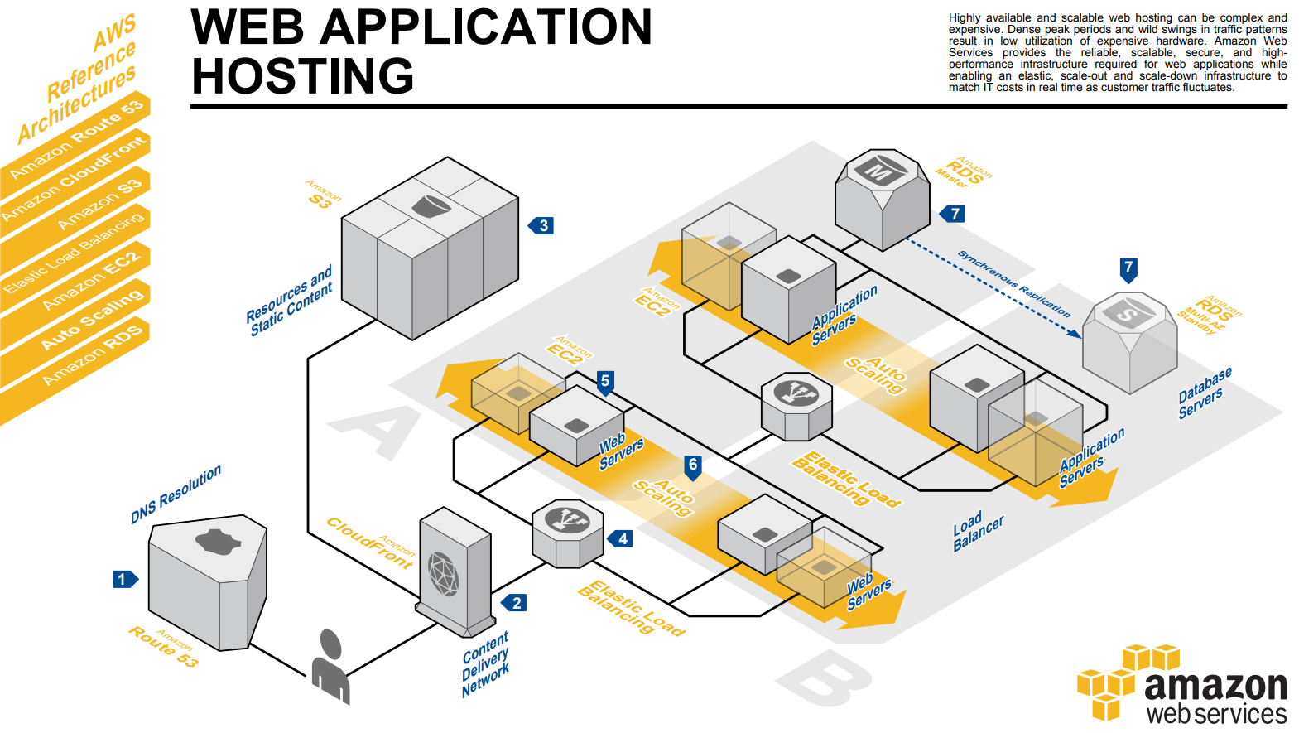
What is “the cloud”?
Notes:
Typical 3-tier web application example. Redundant design. ELB. AS. MAZ

Slide 8
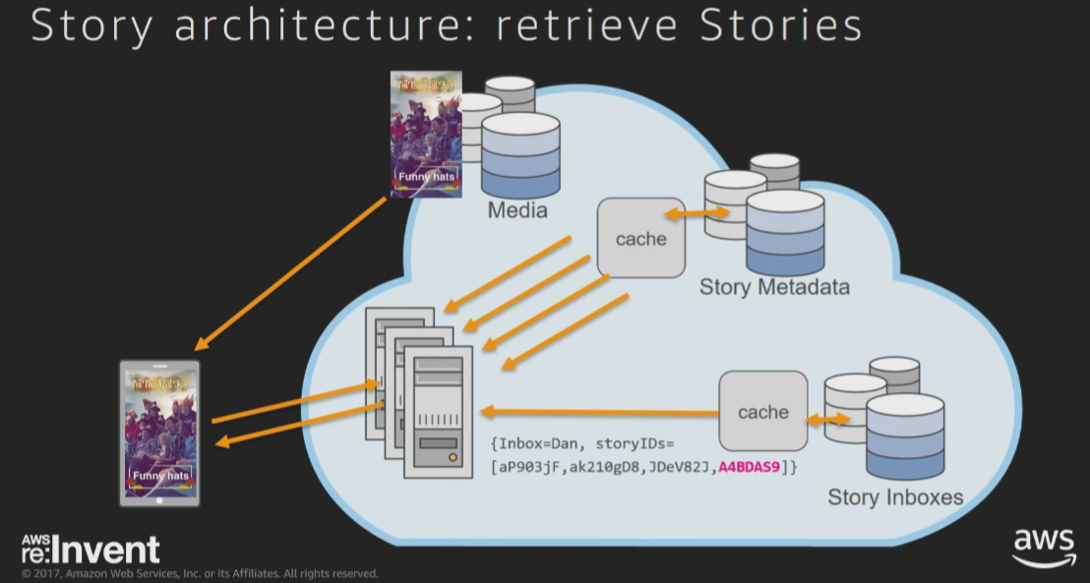

Who uses it?
Snapchat Stories⁹
Notes:
Uber, Snapchat, Spotify, Pinterest

Slide 9
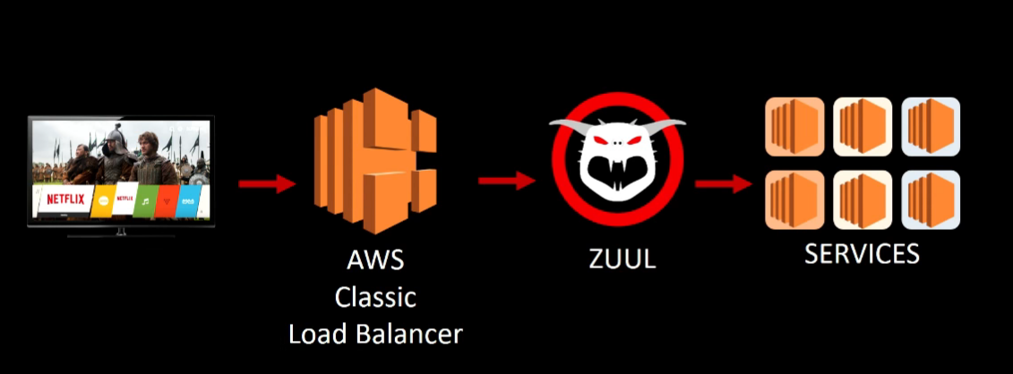
Who uses it?
Netflix – 100,000 instances³
Notes:
Uber, Snapchat, Spotify, Pinterest
Source #3 – 100k EC2 instances 2m30s, 10k auto scaling groups, 1k code changes
Source #3 – 39m20s, 300k CPU reference. 3k M4.16XL instances (64vCPU, 256GB)
Source #3 – 41m20, autoscale 1000s of instances

Slide 10
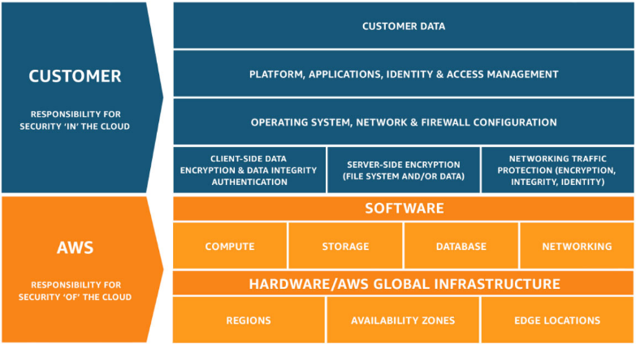
Who owns what?
Cloud vs. Customer Shared Responsibility Model⁴
Notes:
Of the cloud, In the cloud
Renting.

Slide 11
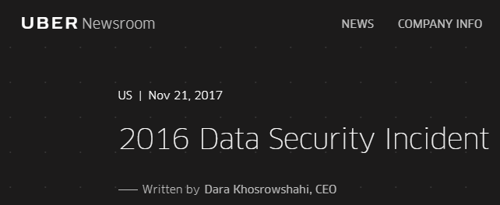
Cloud Breach - Uber
Uber software engineers stored AWS login credentials in GitHub⁵.
Notes:
Breach? First thoughts? Russian hack!?
Who knows what GitHub is?

Slide 12
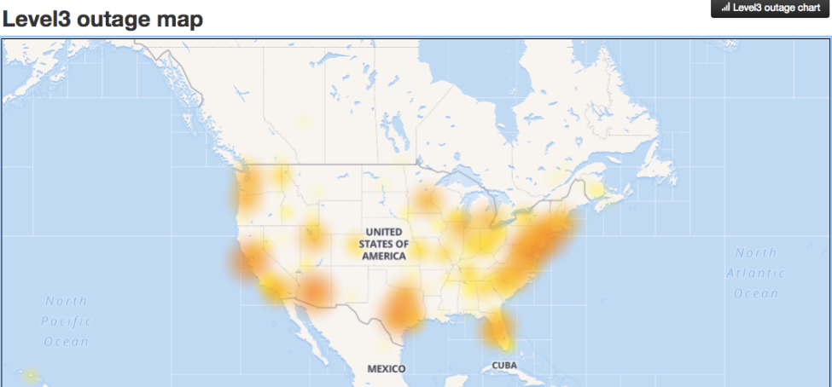
Cloud DoS – AWS S3
Caused by AWS tech inputting a command parameter incorrectly.
S3 outage disrupts many core AWS services.
Notes:
DoS? First thoughts? Russian hack!?
Who knows what S3 is?
Something simple as incorrect input can break “1/3” of the Internet.

Slide 13

Cloud Insider Threat
Malicious vs. Unintentional?
Notes:
What have we observed so far? Who’s more of a concern than you expected? Your neighbor!

Slide 14
Cloud Security Parallels
Access Control - Account Management
Auditing – Host vs Cloud
Firewall – SG, NACL
Identification and Authentication - Password Policy
Least Functionality – Features, Services, Sharing
Permissions – S3, IAM
Patching – Application, System
Notes:
Critical security concepts required in nearly every control framework.

Slide 15
Demo?
Access Control - Account Management
Auditing – Host vs Cloud
Firewall – SG, NACL
Identification and Authentication - Password Policy
Least Functionality – Features, Services, Sharing
Permissions – S3, IAM
Patching – Application, System
Notes:
AWS walkthrough

Slide 16
What we learned…
Cloud can take many shapes and sizes
Ultimately renting computing resources
Many large companies leverage cloud benefits
You own security IN the cloud
Unintentional insider threats
Security IN the cloud conceptually parallels standard practices

Slide 17
References
What is Cloud Computing? AWS. Retrieved on July 17, 2018, from https://aws.amazon.com/what-is-cloud-computing/
Our Data Centers. AWS. Retrieved on July 17, 2018, from https://aws.amazon.com/compliance/data-center/controls/
A Day in the Life of a Netflix Engineer III (ARC209). https://www.youtube.com/watch?v=T_D1G42G0dE
Shared Responsibility Model. AWS. Retrieved on July 10, 2018, from https://aws.amazon.com/compliance/shared-responsibility-model/
Uber Paid Hackers to Delete Stolen Data on 57 Million People. Bloomberg. Retrieved on July 17, 2018, from https://www.bloomberg.com/news/articles/2017-11-21/uber-concealed-cyberattack-that-exposed-57-million-people-s-data

Slide 18
References
Summary of the Amazon S3 Service Disruption in the Northern Virginia (US-EAST-1) Region. AWS. Retrieved on July 17, 2018, from https://aws.amazon.com/message/41926/
Amazon Just Broke the Internet. Gizmodo. Retrieved on July 17, 2018, from https://gizmodo.com/amazon-just-broke-the-internet-1792827856
The Early Indicators of an Insider Threat. DigitalGuardian. Retrieved on July 17, 2018, from https://digitalguardian.com/blog/early-indicators-insider-threat
AWS re:Invent 2017: Snapchat Stories on Amazon DynamoDB (DAT325). Retrieved on July 17, 2018, from https://www.youtube.com/watch?v=WUleQzu9l_8

